Slide 1

GRAFUN ELECTRONICS COMPANY ANALYSIS 2023-2024 PRESENTED BY: FUNMILAYO ADEKUNLE GRACE OLUWATOSIN AJALA

Slide 2

COMPANY’S OVERVIEW
ABOUT US
Adekunle Oluwafunmilayo and Grace Oluwatosin Ajala are the co-founder of the GRACFUN ELECTRONIC company which was established in 3rd of June 2023.
OUR MISSION
GRACFUN Electronics company follows a simple business philosophy: to produce and sell superior electronic goods that contribute to the society.

Slide 3

INTRODUCTION
GRACFUN Electronics sells gadgets/appliances online to 11,000 daily customers, with 5 warehouses (A-E) and shipping via flight, road, or ship.

Slide 4

Some KPI’S of the company before the analysis
The following are the KPI’S of the company before the analysis
Customer demography.
Customer satisfaction.
Importance of products.
Preferred mode of shipment.
Promptness of shipment completion.
Warehouse blocks usage (the company has 5 different warehouse blocks).

Slide 5
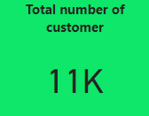
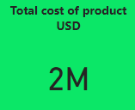

STATISTICAL ANALYSIS OF GRACFUN ELECTRONICS COMPANY(2023-2024)

Slide 6
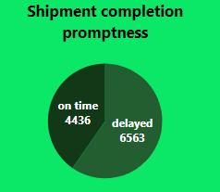
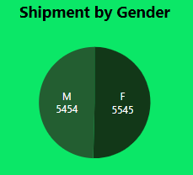

Slide 7
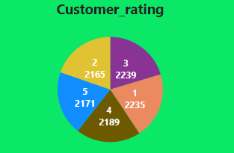
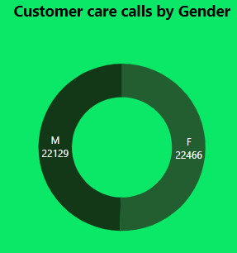

Slide 8
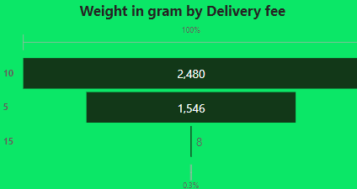
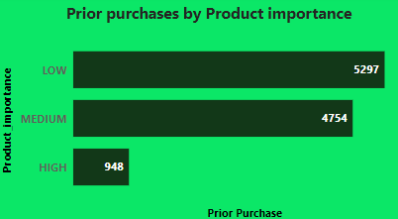

Slide 9
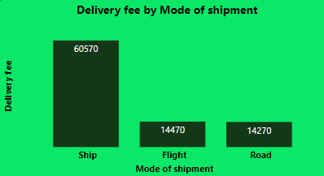
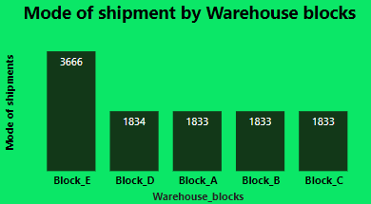

Slide 10
CONCLUSION
Recommended KPI’s for the company sales dataset after the analysis alongside engagement with marketing campaigns can help in identifying high-value customers and implementing strategies to retain and maximize their value over time.
These KPI’s includes:
Customer Lifetime Value
Customer Acquisition Cost
Cart Abandonment Rate
Net Promoter Score

Slide 11
THANKS FOR LISTENING

